Slide 1

Predicting Survival of Patients with Heart Failure.
Intended Audience: Healthcare Professionals, Medical Researchers, Students and Educators
DATASCI 207: Applied Machine Learning
Fall 2024
Jasmol Dhesi, Jason Chang, Kent Bourgoing, Sebastian Rosales, Sergey Nam
Notes:
Jason:
Intended Audience:
Healthcare professionals: Cardiologists, general practitioners, and nurses who treat or monitor heart failure patients.
Medical researchers: Individuals focused on clinical research, biostatistics, and epidemiology
Students and educators: Especially in medicine, nursing, public health, and data science fields

Slide 2

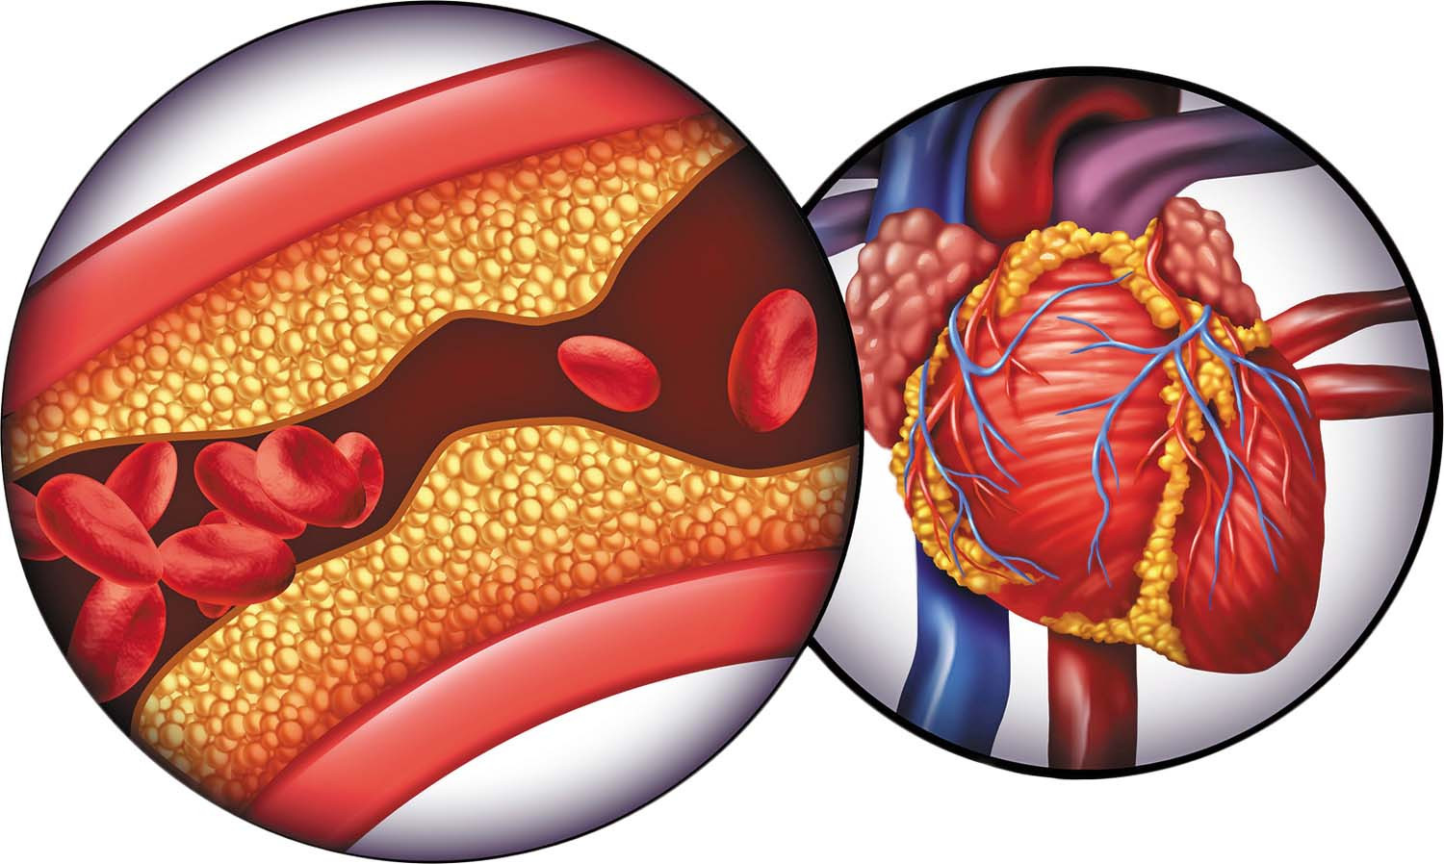
Motivation
Cardiovascular diseases, such as heart failure, are responsible approximately 17 million deaths worldwide each year (WHO, 2021).
Notes:
Jason: Cardiovascular diseases (CVDs) are a group of disorders of the heart and blood vessels.
Key facts from the World Health Organization (WHO):
Cardiovascular diseases are the leading cause of death globally, representing 32% of all global deaths.
Complications of heart failure depend on your age, overall health and the severity of heart disease. They may include:
Kidney damage or failure
Liver damage
Sudden cardiac death

Slide 3
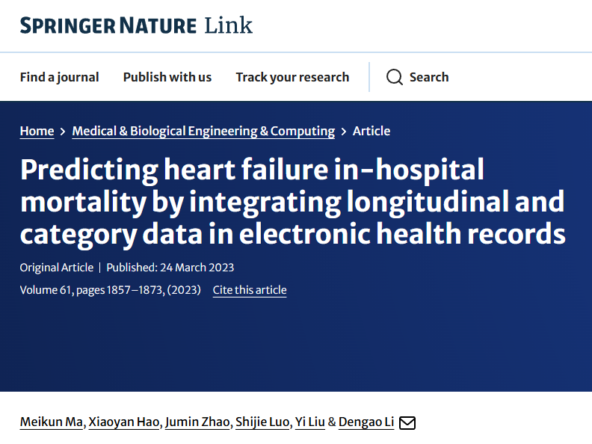

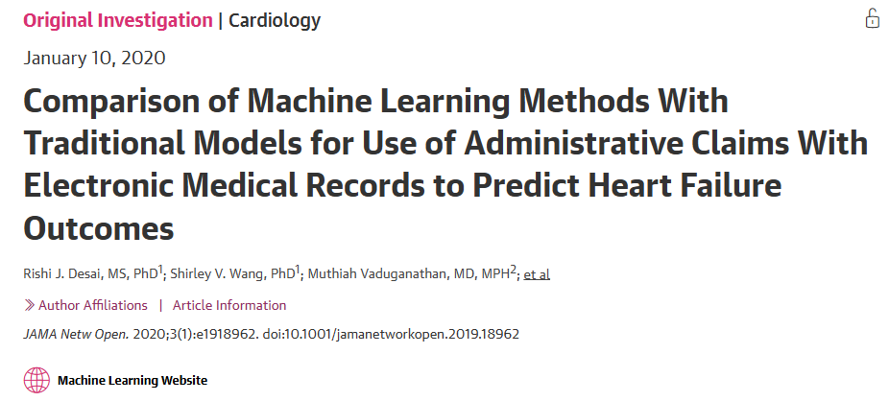
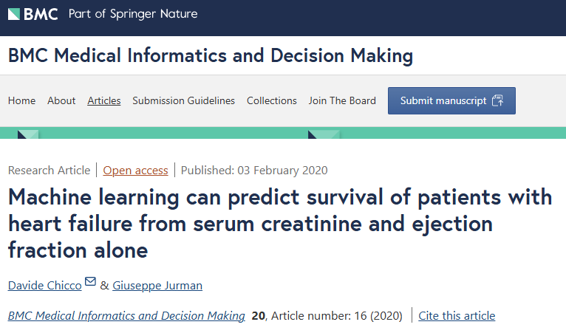
Motivation (cont.)
Notes:
Jason: Healthcare professionals, increasingly rely on medical records to predict mortality risk in heart failure patients. Recent studies have leveraged machine learning models, including deep fusion learning for integrating time-series and categorical data, logistic regression, and advanced approaches like gradient boosting and ensemble models for improved predictive accuracy.

Slide 4

Research Question
How accurately can machine learning models predict survival outcomes among heart failure patients based on clinical features extracted from electronic medical records?
Secondary Interest: How does the predictive accuracy of different machine learning algorithms compare in this context?
Notes:
Kent:
Our goal is to advance research that contribute to the medical field, particularly in cardiovascular care. With so many machine learning models aiming to predict mortality risk in heart failure (HF) patients, we aim to address an important question:
How accurately can machine learning models predict survival outcomes among heart failure patients using clinical features from electronic medical records?
Additionally, we aim to answer a secondary question:
How does the predictive accuracy of different machine learning algorithms compare in this context?
In essence, we’re not only interested in how well machine learning models predict mortality risk but also in evaluating and identifying the most effective algorithms for this purpose.

Slide 5





Dataset Overview
Source: 299 heart failure patients, Faisalabad, Pakistan (2015)
Collected from: Faisalabad Institute of Cardiology & Allied Hospital
Features: 13 clinical, demographic, and lifestyle factors
Notable Factors: Age, sex, ejection fraction, serum creatinine, anemia, diabetes, high blood pressure
Target: Survival outcome (died or survived)
Follow-up period: Average of 130 days
Demographics: 105 women, 194 men, ages 40-95
Notes:
Kent:
In order to answer these questions, let’s first introduce our dataset, which was sourced from the UCI Machine Learning Repository and originally used in a study published by BMC. It originates from research conducted at a Cardiology Institute and a hospital in Pakistan.
The dataset consists of medical records from 299 heart failure patients, collected between April and December 2015. Patients ranged in age from 40 to 95, with 105 women and 194 men. It includes 13 features such as age, sex, ejection fraction, serum creatinine, and indicators for anemia, diabetes, and high blood pressure. The target variable indicates whether each patient survived or died during an average follow-up period of 130 days.

Slide 6
Features Of Interest
Age: Older age increases risk for cardiovascular events and complicates heart failure management, making it a key mortality predictor.
High Blood Pressure: Elevated blood pressure indicates that the heart is working harder and over long periods of time can lead to chronic heart failure increasing the mortality risk.
Ejection Fraction (EF): Low EF reflects reduced cardiac efficiency and is strongly linked to heart failure severity, essential for assessing patient prognosis.
Platelets: Abnormal platelet levels can indicate cardiovascular complications like thrombosis, impacting survival rates in heart failure.
Serum Creatinine: Elevated levels indicate impaired kidney function, which is closely linked to poor outcomes in heart failure patients.
Serum Sodium: Low sodium (hyponatremia) often marks fluid imbalance and disease severity, impacting mortality risk.
Time (Follow-Up Period in Days): Represents patient monitoring follow-up period, helping assess disease progression and survival trends over time.
Notes:
Sebastian:
So, moving on to our features of interest. We were interested in understanding how well we can predict the survivability of patients with heart failure. And to do so, we used features such as age, high blood pressure, Ejection Fraction, Platelets, Serum Creatinine, Serum Sodium, and a follow-up period measured in days.

Slide 7
Data Preprocessing and Augmentation
No major data quality issues:
No null values
No duplicate records
No data type issues
Preprocessing:
Shuffling records
Split data using a 60/20/20 train test and validation split
Standardize data using the training dataset
Augmentation:
Use Bayesian Information Criterion (BIC) to fit a Gaussian Mixture Model (GMM) with the most optimal amount of clusters
Generate 5000 samples from the GMM to augment dataset from 299 to 5299 records
Clean up binary data columns and standardize samples with original training dataset
Notes:
Sebastian:
Now moving on to our data preprocessing and augmentation. We were fortunate to have a dataset that was already fairly clean, there were no null values, no duplicate records, and no issues with data types. Therefore, our preprocessing solely consisted of shuffling records, splitting the data using a 60/20/20 train test and validation split, and standardizing the data with the training dataset. However, a downside to this dataset was that we were limited to only having 299 records. Therefore, we attempted to address this with an experimental data augmentation that consisted of finding the most optimal amount of clusters for our Gaussian Mixture Model using the Bayesian Information Criterion. We then fit the Gaussian Mixture Model with our dataset to capture the underlying distributions of our data and generate 5000 samples. These samples then had to be cleaned up and standardized using the original training dataset and were used in hopes of improving our model results.
**Our dataset was in good shape—no major data quality issues such as null values, duplicates, or data type mismatches.
For preprocessing, we shuffled the records and performed a 60/20/20 split for training, validation, and testing. Then, we standardized the data using the training dataset to ensure consistency across splits.
To augment the data, we used the Bayesian Information Criterion (BIC) to determine the optimal number of clusters for a Gaussian Mixture Model (GMM). We expanded the dataset by 5,000 samples and standardized the augmented samples using the original training dataset and ensured data columns were clean and consistent.**

Slide 8
Project Plan
Baseline Model
Majority Classification
Supervised ML Models
Unsupervised ML Models
Parametric ML Models
Non-Parametric ML Models
- K-Means Clustering
- Agglomerative Hierarchical Clustering
- Density-Based Spatial Clustering (DBSCAN)
- Gaussian Mixture Model (Data Augmentation)
- PCA/SVD*
- Logistic Regression
- Neural Network
- Functional API
- K-Nearest Neighbors (KNN)
- Decision Tree
- Majority Vote (Ensemble)
- Random Forest
- Bagging
- Gradient Boosting
- Adaptive Boosting (AdaBoost)
Notes:
Sebastian:
Moving on to our project plan, as we mentioned during the baseline presentation we decided to have a majority-class classifier baseline model. As for the model improvements, we decided to have all of us test a wide variety of parametric, non-parametric, and even unsupervised models, and we will dive into all those results shortly.

Slide 9
Model Performance Metrics
Chosen Metric: Accuracy
Reason: Simple and suitable as our dataset is balanced between death and survival cases.
Alternative Metrics
Precision: Useful if false positives (predicting death when survival occurs) should be minimized.
Recall: Essential if catching all true death cases is critical, even with some false positives.
F1 Score: Balances precision and recall, ideal for imbalanced datasets.
AUC-ROC: Measures model’s ability to distinguish classes, helpful if class imbalance is present.
Loss: Helpful in understanding the amount of errors in the test set.
Notes:
Sergey:
The model performance metrics that we chose are as follows:
Accuracy which measures overall correct predictions, and is suitable for balanced datasets.
Precision focuses on minimizing false positives (like wrongly predicting death when survival occurs).
Recall, also called Sensitivity, ensures we catch all positive cases, which is crucial in medical contexts.
The F1 Score provides a balanced perspective by combining Precision and Recall into a single metric, making it particularly useful for imbalanced datasets.
AUC-ROC (Area Under the Curve - Receiver Operating Characteristic) evaluates how well the model distinguishes between classes across all possible classification thresholds, making it another good choice for imbalanced data.
Test loss measures how well each model's predictions align with the actual outcomes, with lower values indicating better model performance and less error on the test set.

Slide 10
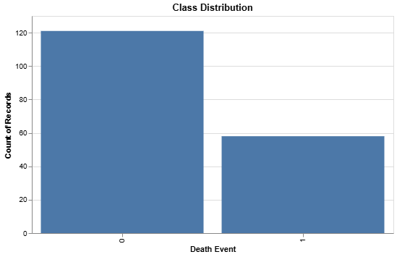
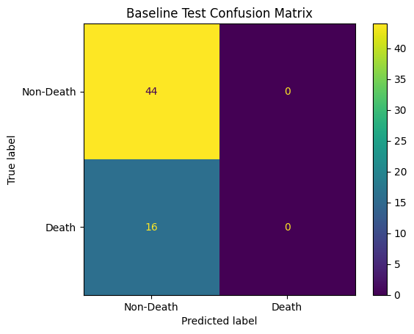
Baseline Model
Model: Majority Class Classifier
Within the training dataset we have a total of 179 records
121 non-deaths
58 deaths
Training Accuracy: 67.59%
Training Loss: 11.94
Validation Accuracy: 63.33%
Validation Loss: 13.51
Test Accuracy: 73.33%
Test Loss: 9.82
Notes:
Sebastian:
So first we will talk briefly about our baseline model results. So early on, we saw a class imbalance within our training dataset which is representative of that 67.59% accuracy and 11.94 training loss. For the validation, we got an accuracy of 63.33% and a loss of 13.51. Lastly, for Test accuracy, we got 73.33% and a test loss of 9.82. Although the accuracies are better than a random classifier, they aren’t as useful given that we are not predicting any deaths and as a result, we are putting patients at risk of not receiving the right care.

Slide 11
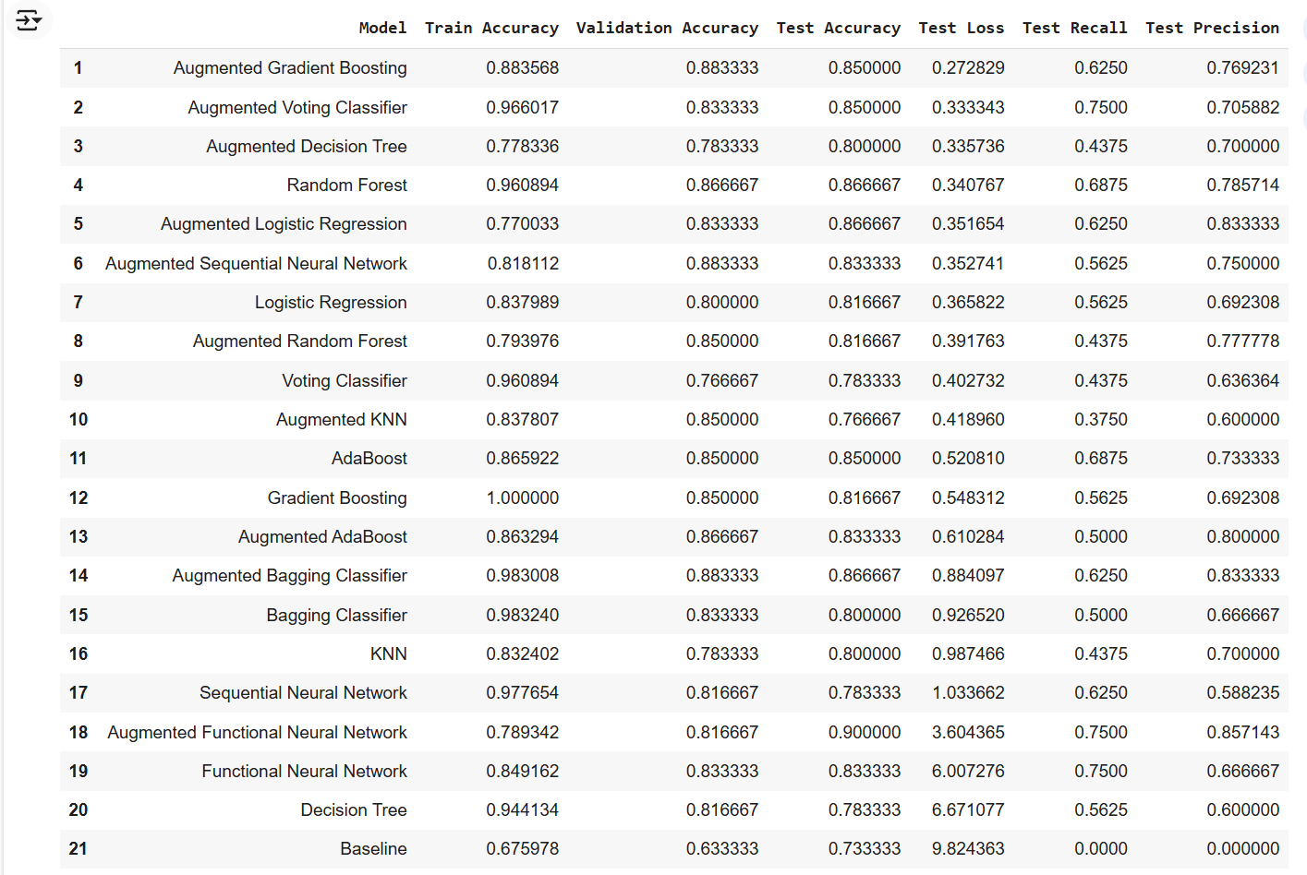
Model Results
 | Test Accuracy | Validation Accuracy | Test Accuracy | Test Loss | Test Recall | Test Precision
Mean | 88.85% | 83.67% | 82.42% | 1.3574 | 56.25% | 72.44%
SD | 7.66% | 3.32% | 3.17% | 0.0317 | 10.92% | 8.63%
Notes:
Jason:
This table summarizes the performance metrics for the various models we evaluated. The models are ranked by their test accuracy, along with key metrics like test loss, recall, and precision. One thing to note: the augmented models, especially Gradient Boosting and Voting Classifier, performed particularly well, highlighting the impact of data augmentation for model performance.

Slide 12
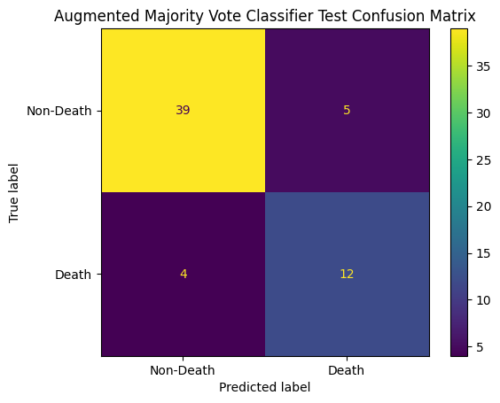
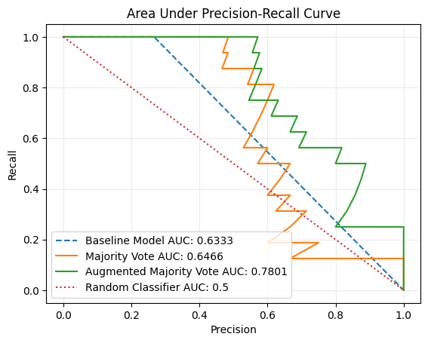
Augmented Voting Classifier Model
Model: Augmented Majority Vote
Training Accuracy: 0.9660
Training Loss: 0.2201
Validation Accuracy: 0.8333
Validation Loss: 0.3735
Test Accuracy: 0.8500
Test Recall: 0.7500
Test Precision: 0.7059
Notes:
Jason:
Overall reliable performance:
Strong training accuracy indicates effective learning.
83.3% validation accuracy suggests good generalization.
Training and validation loss values highlight a manageable increase in error
85% validation performance indicates robust predictions
Recall and Precision both around 70% shows a moderate trade-off between true positive and false positives

Slide 13
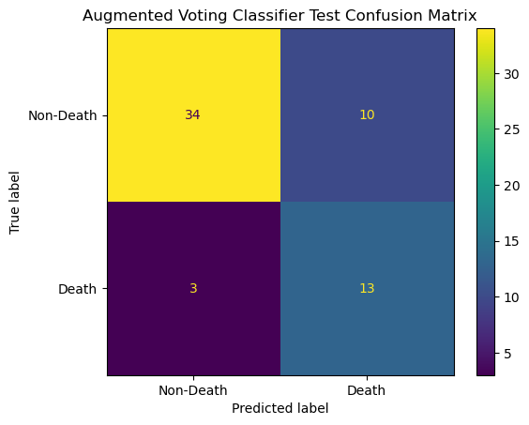
Augmented Voting Classifier Model
Improved
Probability-Based Voting (Soft): Instead of using hard voting, soft voting helped make a weighted decision. This improved performance by leveraging the confidence of each estimator.
Decision Boundary: Lowering the threshold to 0.25 shifts our focus to improving recall. Reducing false negatives is imperative when working with mortality prediction.
Cross-Validation: Tested different values of nearest neighbors and verified that k=5 provided the best balance of performance metrics. (accuracy, precision, and recall)
Notes:
Jason:
I chose to use three different estimators to have enough diversity in capturing data patterns, but wanted to avoid significant overfitting. Having only two models would improve the overfitting, but the tradeoff would be in making good predictions.
Logistic Regression for Linear relationships
K-Nearest Neighbors for simple non-linear relationships
Decision Tree for complex non-linear relationships

Slide 14
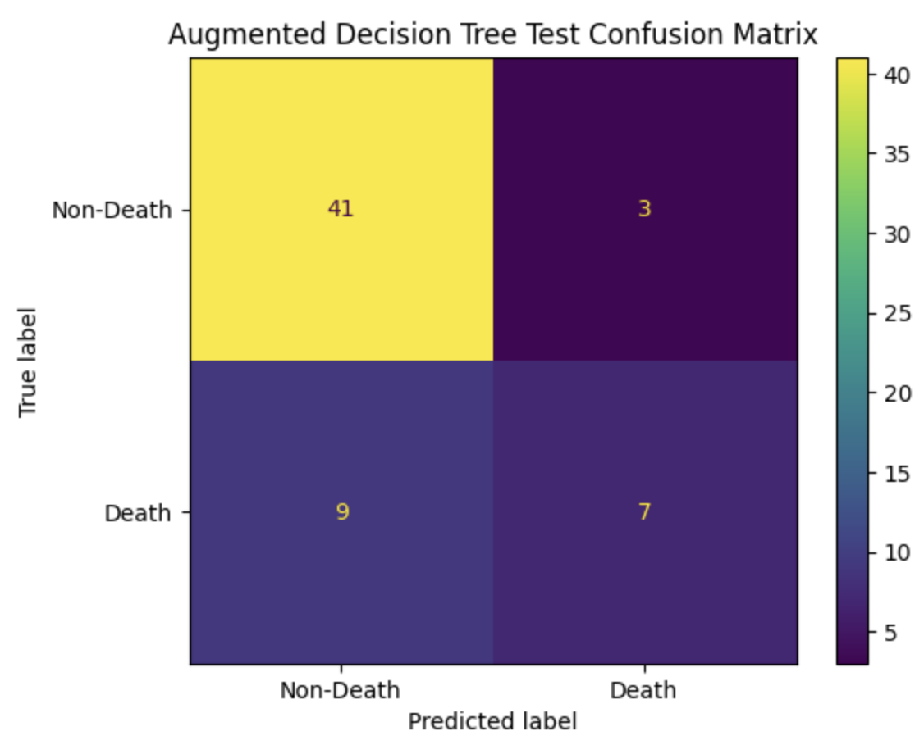
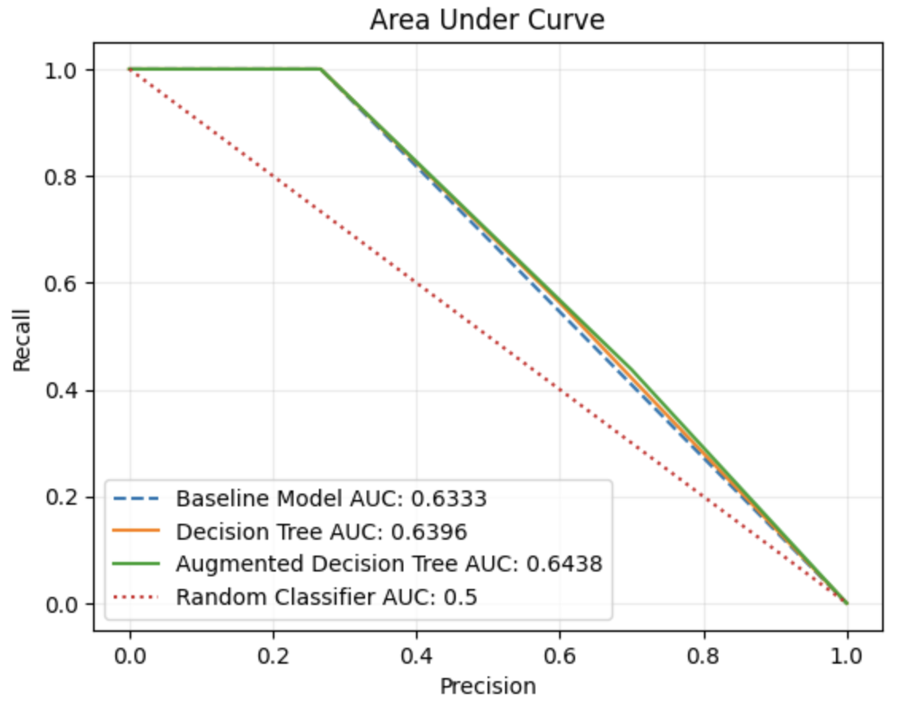
Augmented Decision Tree Model
Model: Augmented Decision Tree
Training Accuracy: 0.7783
Training Loss: 0.4677
Validation Accuracy: 0.7833
Validation Loss: 0.4098
Test Accuracy: 0.8000
Test Recall: 0.4375
Test Precision: 0.7000
Notes:
Sergey
The Augmented Decision Tree Model achieves a test accuracy of 80%, with a test recall of 43.75% and a test precision of 70%, highlighting its focus on precision while missing some true positive cases. The AUC score of 0.6438 shows moderate improvement over the baseline and standard decision tree models, reflecting its ability to balance true positive and false positive rates. The confusion matrix shows strong classification performance for "Non-Death" cases but room for improvement in identifying "Death" cases.

Slide 15
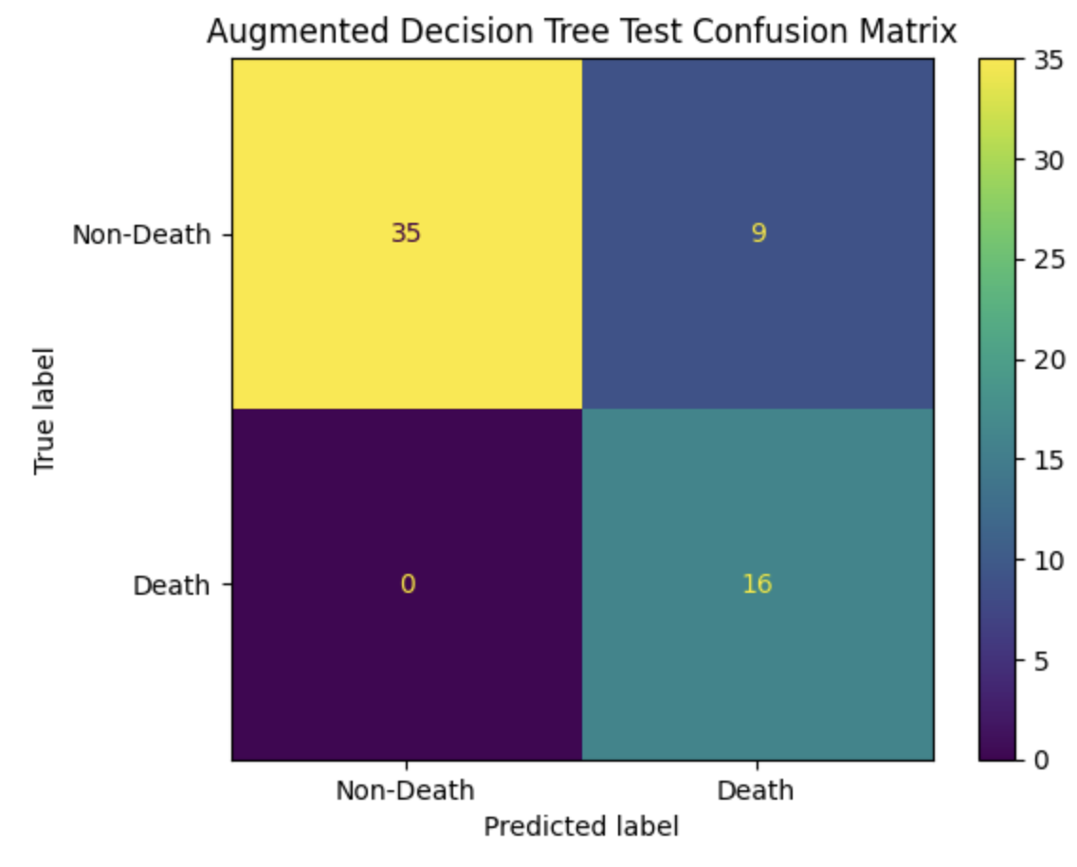
Augmented Decision Tree Model
Hyperparameter Tuning
Max Depth: The maximum depth of the tree determines the number of levels it can expand. The model with `max_depth=5` achieved the best performance by striking a balance between simplicity and complexity, avoiding overfitting while capturing sufficient patterns to generalize effectively to unseen data. Smaller values led to underfitting, while larger values caused overfitting.
Decision Boundary: When predicting death events for heart patients, a threshold of 0.3 is more suitable in situations where missing an at-risk patient could result in fatal consequences. However, this approach increases the likelihood of false positives, which must be carefully assessed based on the available resources and the potential impact of unnecessary interventions.
Notes:
Sergey
The Augmented Decision Tree Model was configured with `max_depth=5` to balance simplicity and complexity, preventing overfitting while capturing meaningful patterns in the data. A decision boundary threshold of 0.3 was chosen to increase recall, ensuring more "Death" cases are identified, though this approach leads to more false positives. The confusion matrix shows the model correctly identified 35 Non-Death cases and 16 Death cases, but misclassified 9 Death cases as Non-Death. This threshold adjustment highlights the trade-off between precision and recall, suitable for scenarios where missing true positives has severe consequences.

Slide 16
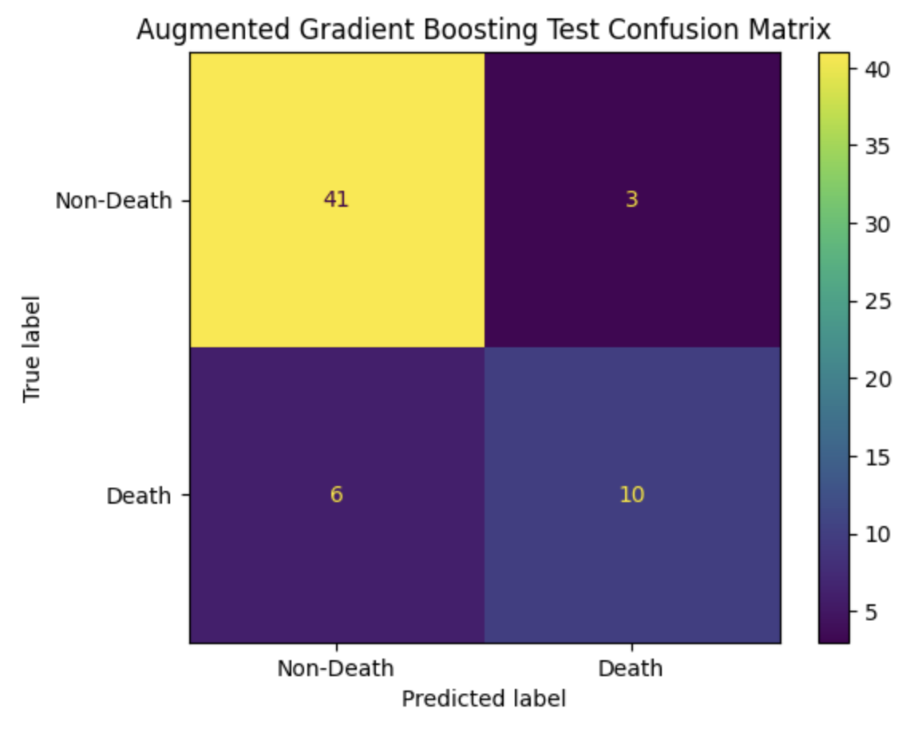
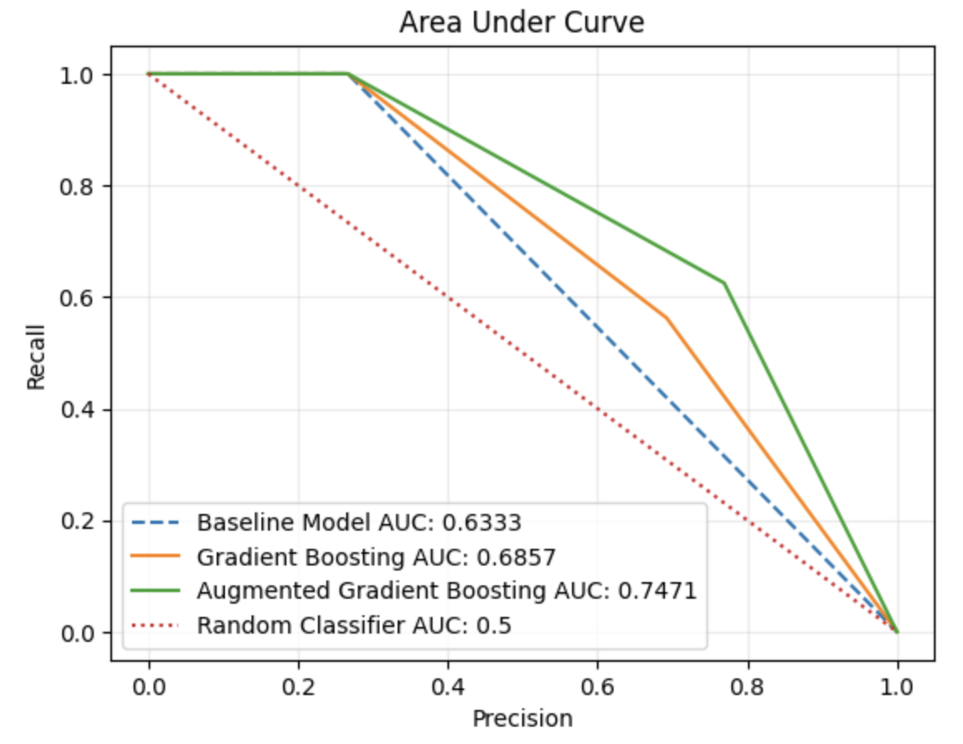
Augmented Gradient Boosting Model
Model: Augmented Gradient Boosting
Training Accuracy: 0.8836
Training Loss: 0.3068
Validation Accuracy: 0.8833
Validation Loss: 0.2926
Test Accuracy: 0.85
Test Recall: 0.6250
Test Precision: 0.7692
Notes:
Sergey
The Augmented Gradient Boosting Model achieves strong performance with a training accuracy of 88.36%, validation accuracy of 88.33%, and test accuracy of 85%, balancing precision (76.92%) and recall (62.50%). Its AUC of 0.7471 demonstrates improved classification ability compared to the baseline and standard Gradient Boosting models, with effective identification of "Death" cases while minimizing false positives.

Slide 17
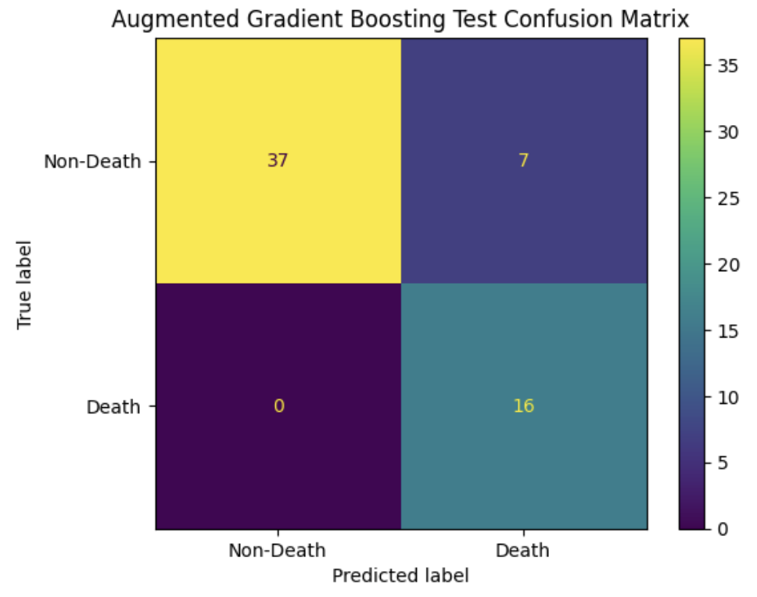
Augmented Gradient Boosting Model
Hyperparameter Tuning
Max Depth: The choice of `max_depth=4` limits the complexity of individual trees, preventing overfitting while allowing the model to capture meaningful patterns in the data.
Number Estimators: The choice of `n_estimators=200` strikes a balance between improving the model's ability to learn complex patterns and avoiding overfitting or excessive training time. It provides sufficient iterations for boosting to refine predictions without overcomplicating the model.
Decision Boundary: Reducing the threshold from 0.5 to 0.25 was chosen to increase recall by capturing all true positive cases ("Death") while tolerating more false positives ("Non-Death" incorrectly classified as "Death"). This approach is suitable in contexts like predicting death events for heart patients, where missing true positive cases could have severe consequences, even at the expense of slightly lower precision.
Notes:
Sergey
The Augmented Gradient Boosting Model uses hyperparameters like `max_depth=4` to limit tree complexity and prevent overfitting, and `n_estimators=200` to balance learning capability and computational efficiency. A reduced decision boundary of 0.25 was chosen to prioritize recall, ensuring all "Death" cases are captured while tolerating more false positives, which is critical in predicting high-risk outcomes like heart patient deaths. This trade-off makes the model effective in scenarios where missing true positives can have severe consequences.

Slide 18
Clustering Approach
Objective:
Identify patterns and structures in the data
Anomaly detection
Data Simplification
Algorithms Used:
K-Means, Density-Based Clustering, Agglomerative Clustering
Dimensionality Reduction Techniques:
Principal Component Analysis (PCA), Singular Value Decomposition (SVD)
Notes:
Jasmol

Slide 19
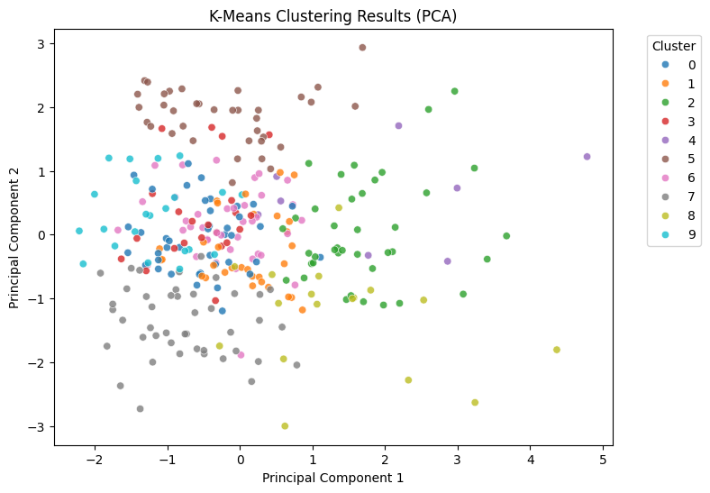
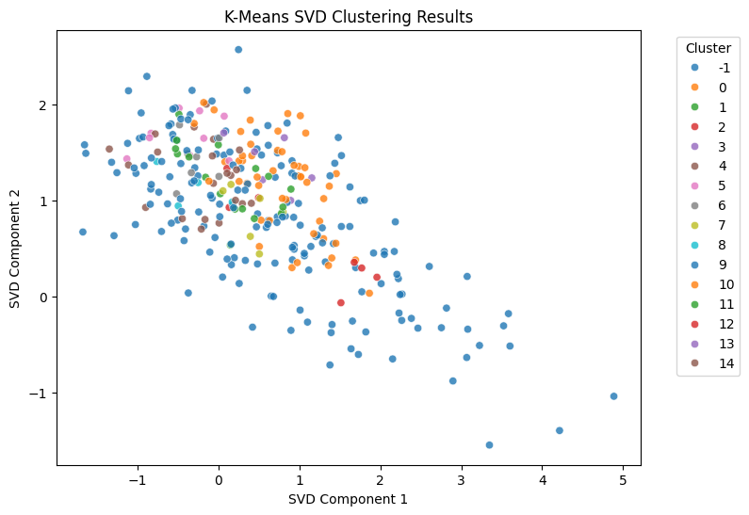
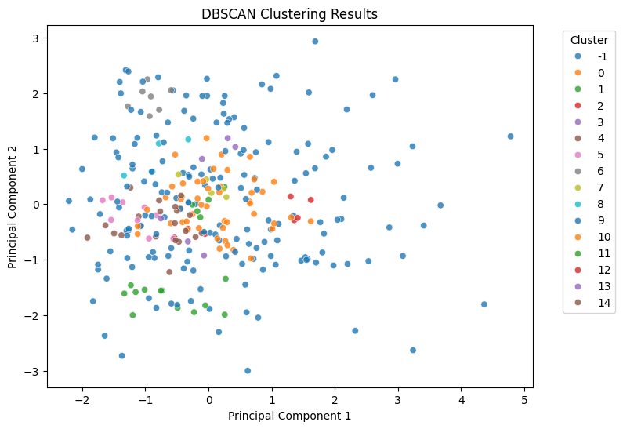
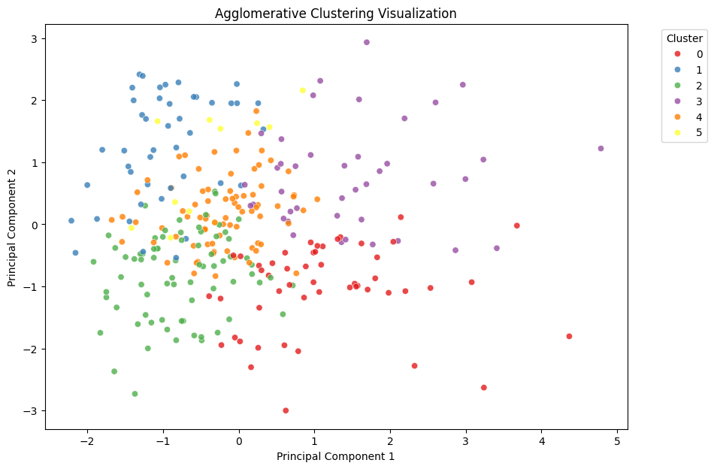
Clustering Results (PCA)
A
B
C
D
Notes:
Jasmol

Slide 20
Clustering Scoring (Silhouette Scores)
Method | Parameters | Silhouette Score (Higher is Better), [-1,1]
K Means | K = 2 | 0.1866
K Means (SVD) | K = 5 | 0.2255
DBSCAN | Epsilon = 0.7, min_samples = 3 | -0.2212
Agglomerative | K = 6 | 0.1688
Silhouette score was used as the metric to evaluate the clustering algorithms. K-Values were decided by selecting the k values associated with optimal silhouette scores.
A silhouette score measures how well-separated and compact your clusters are in a dataset. It ranges from -1 to 1, with higher values indicating better-defined clusters.
The k-means algorithm with SVD applied had the highest silhouette score
Notes:
Jasmol

Slide 21
Clustering Conclusions
Agglomerative Clustering had the highest silhouette score HOWEVER it wasn’t indicative of the data being good for clustering.
A desirable silhouette score is >= 0.5 for defined clusters; no algorithms yielded sufficient results.
As shown in the reduced plots, clusters have significant overlap preventing us from drawing meaningful insights.
Unsupervised Learning was not useful in this context.
It is challenging to determine whether a heart failure patient will die or survive simply by clustering the data, as the groups are not easily separable and individuals from different outcomes often share overlapping clinical features.
Notes:
Jasmol

Slide 22

Conclusion
Machine learning models predicted mortality risk in HF patients with an average accuracy of 85% (SD 5%).
Non-parametric models outperformed parametric models, with a lower average test loss of 0.98 (SD 1.66) vs. 2.25 (SD 2.70).
Augmented models performed better than non-augmented models, with a test loss of 0.99 (SD 1.77) vs. 1.72 (SD 2.31).
Augmented Gradient Boosting was the top model, with accuracy ≥ 0.85, test loss ~0.27, and <3% difference across training, validation, and test accuracies.
Notes:
Kent:
In conclusion:
On average, our machine learning models predicted mortality risk in heart failure patients with an accuracy of 85%, with a standard deviation of 5%.
In addition, non-parametric models performed better than parametric ones, with a lower average test loss of 0.98 compared to 2.25.
Augmented models also outperformed non-augmented ones, achieving a lower test loss of 0.99 versus 1.72, which highlights the value of incorporating additional data into the models.
Finally, Augmented Gradient Boosting was our best model. It delivered high accuracy across all datasets (≥ 85%), maintained a low test loss of around 0.27, and showed strong generalization with less than a 3% difference between training, validation, and test accuracies.

Slide 23

Conclusion
Potential Biases
Augmented Data Validity: The GMM-based data augmentation may not fully capture the true distribution, potentially affecting result reliability.
Generalization Bias: Limited to two hospitals in Pakistan, with an age bias (40–95 years) and gender imbalance (194 males vs. 105 females), restricting broader applicability.
Notes:
Kent:
However, there are a few potential biases in our experiment to keep in mind:
First, the data augmentation process could introduce bias. While the Gaussian Mixture Model (GMM) was used to generate synthetic data, it’s possible that these augmented samples don’t fully represent the true distribution of the original dataset. This could affect the validity of our results and introduce inaccuracies during model training.
Second, there’s a generalization bias. Our study was conducted in just two hospitals in Pakistan, which limits how applicable our findings are to other regions, healthcare systems, or populations. Additionally, the dataset has some demographic biases. All patients were aged between 40 and 95, and the majority were male (194 males compared to 105 females). These factors could limit the relevance of our results for younger patients or more diverse populations.

Slide 24

Conclusion
Models did not exceed 90% accuracy across training, validation, and testing datasets.
Predictions should complement, not replace, healthcare professionals' clinical judgment
Future Work:
Explore advanced machine learning algorithms beyond DATASCI 207 for improved accuracy.
Focus on hyperparameter tuning for flexible models like Sequential Neural Networks and Functional API.
Conduct a deeper bias and fairness analysis.
Notes:
Kent
Our models didn’t achieve an accuracy above 90% across training, validation, and testing, which shows just how complex it is to predict mortality in healthcare patients. This is largely because patient data is highly variable, and outcomes can differ significantly.
Even with models reaching about 85% accuracy, it’s crucial to remember these predictions are just a tool to support decision-making. Healthcare professionals should always rely on their clinical expertise and judgment when making final decisions for patient care. For future work, we plan to explore more advanced machine learning algorithms beyond what was covered in this course, with the goal of improving predictive accuracy.
We’ll also plan to focus on hyperparameter tuning, especially for flexible models like Sequential Neural Networks and those built using the Functional API, to further optimize their performance.
Additionally, we aim to conduct a more in-depth analysis of bias and fairness in our models to ensure they provide equitable and reliable predictions.

Slide 25
References
Data Set Link from UCI ML Repo: https://archive.ics.uci.edu/dataset/519/heart+failure+clinical+records
Davide Chicco, Giuseppe Jurman: "Machine learning can predict survival of patients with heart failure from serum creatinine and ejection fraction alone". BMC Medical Informatics and Decision Making 20, 16 (2020). https://doi.org/10.1186/s12911-020-1023-5
World Health Organization. (2021, June 11). Cardiovascular diseases (cvds). World Health Organization. https://www.who.int/news-room/fact-sheets/detail/cardiovascular-diseases-(cvds)#:~:text=Key%20facts%201%20Cardiovascular%20diseases%20%28CVDs%29%20are%20the,2019%2C%2038%25%20were%20caused%20by%20CVDs.%20More%20items
Mayo Clinic. (2023, April 20). Heart failure. https://www.mayoclinic.org/diseases-conditions/heart-failure/symptoms-causes/syc-20373142

Slide 26
GitHub Repository
https://github.com/JasmolSD/207_007_final_project

Slide 27
Individual Contributions
Jasmol Dhesi: K-Means, DBSCAN, Agglomerative Clustering, SVD, PCA
Jason Chang: KNN, Majority Vote, Bagging
Kent Bourgoing: Slides, Functional API Neural Network, AdaBoost, and model result statistics
Sebastian Rosales: Data preprocessing, Data augmentation with Gaussian Mixture Model, Baseline Model, Logistic Regression, Sequential Neural Network, Decision Boundary exploration
Sergey Nam: Decision Tree, Random Forest, Gradient Descent, Zoom meetings

